Slide 1
IŞIĞIN KIRILMASI VE MERCEKLER

Slide 2
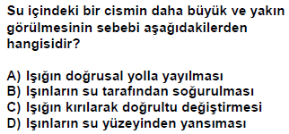
2000 DPY 5

Slide 3
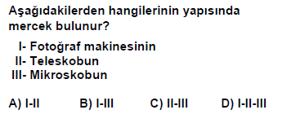
2000 DPY 5

Slide 4
2001 DPY 5

Slide 5
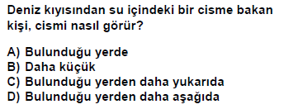
2001 DPY 5

Slide 6
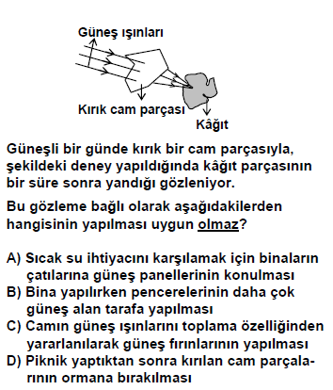
2007 DPY 5

Slide 7
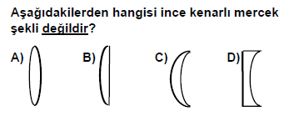
1998 DPY 6

Slide 8
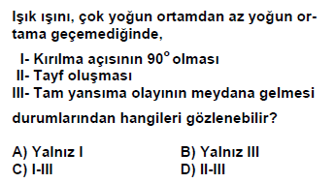
2001 DPY 6

Slide 9
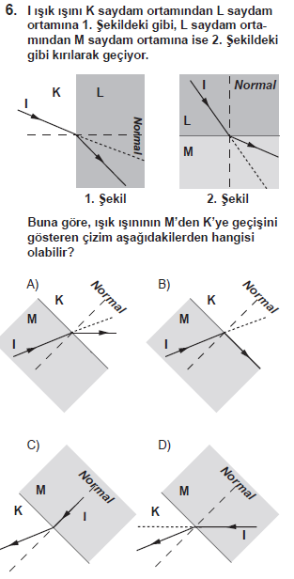
2009 SBS 7

Slide 10
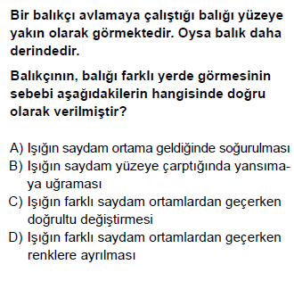
2013 PYBS 7

Slide 11
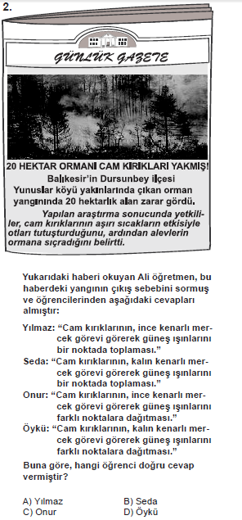
2010 SBS 7

Slide 12
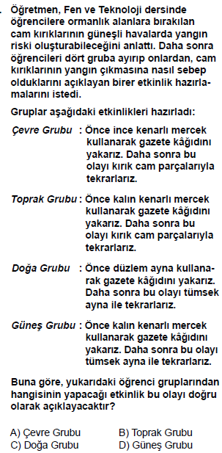
2011 SBS 7

Slide 13
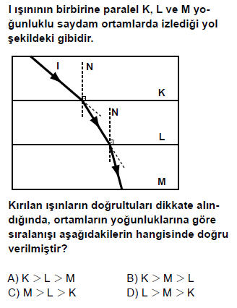
2012 PYBS 7

Slide 14
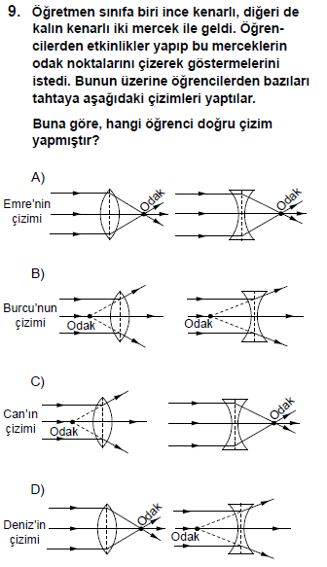
2012 SBS 7

Slide 15
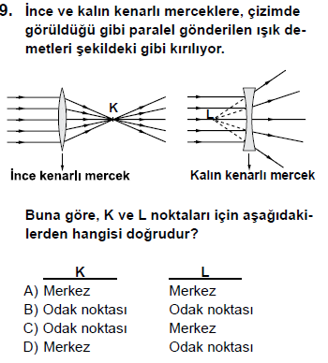
2013 PYBS 7

Slide 16
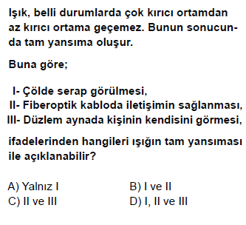
2014 PYBS 7

Slide 17
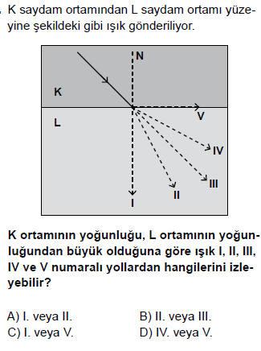
2015 PYBS 7

Slide 18
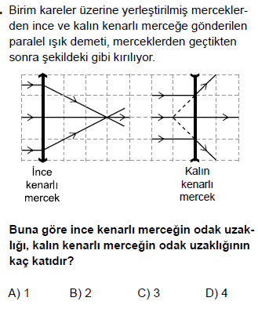
2015 PYBS 7

Slide 19
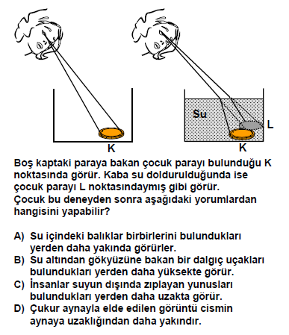
2000 OKS

Slide 20
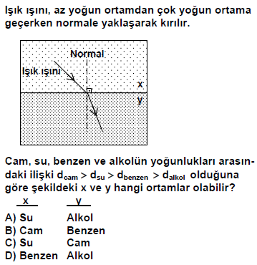
2003 OKS

Slide 21
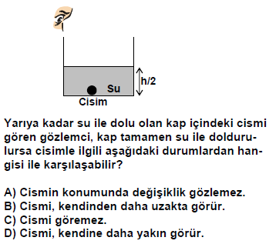
2005 OKS

Slide 22
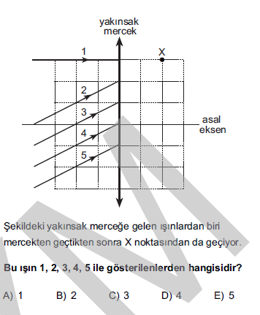
2012 ALS

Slide 23
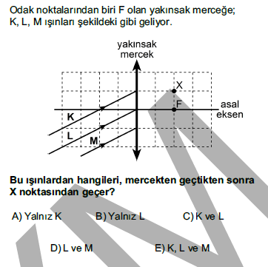
2013 ALS

Slide 24
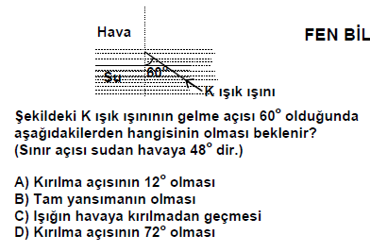
1998 DPY 8

Slide 25
SESİN SÜRATİ

Slide 26
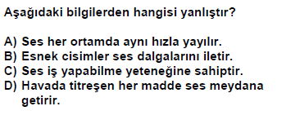
2000 DPY 5

Slide 27
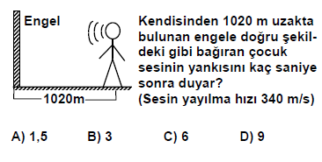
2000 DPY 5

Slide 28
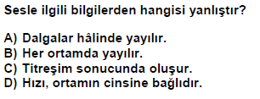
2001 DPY 5

Slide 29
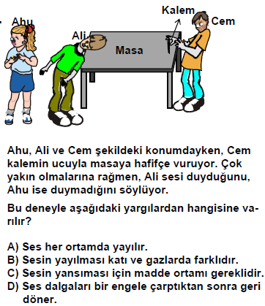
2002 DPY 5

Slide 30
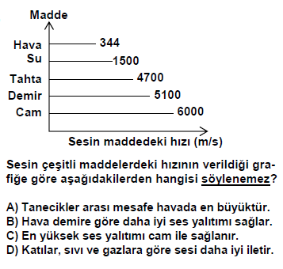
2005 DPY 5

Slide 31
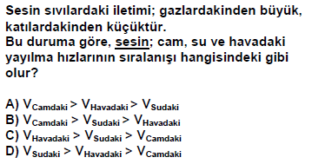
2004 DPY 5

Slide 32
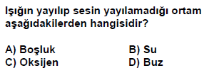
2007 DPY 5

Slide 33
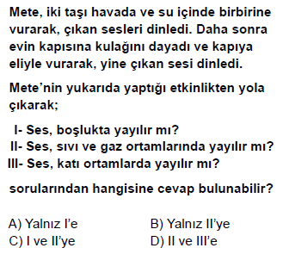
2012 PYBS 5

Slide 34
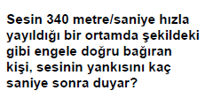
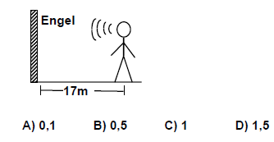
1999 DPY 7

Slide 35
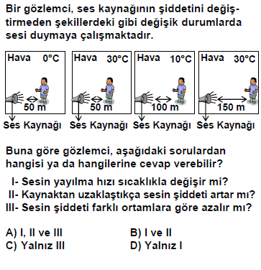
2005 OKS

Slide 36
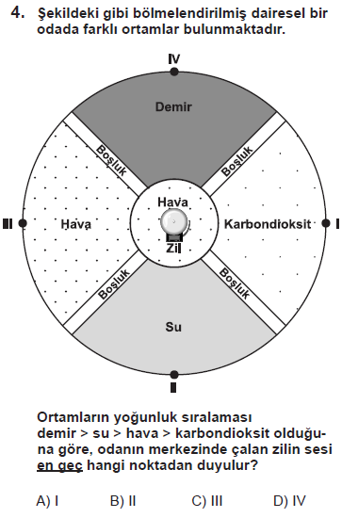
2009 SBS

Slide 37
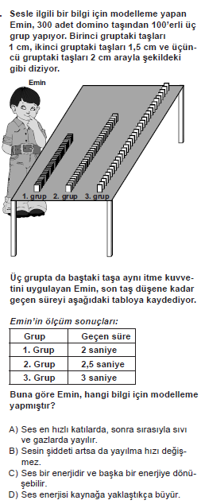
2010 SBS

Slide 38
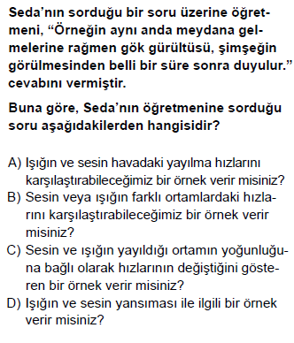
2012 SBS

Slide 39
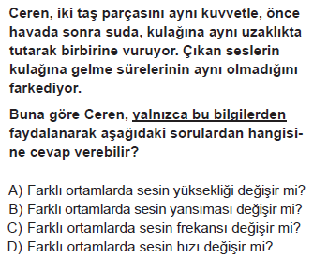
2014 TEOG NİSAN

Slide 40
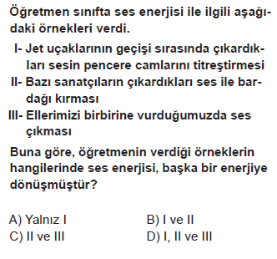
2014 TEOG MAYIS

Slide 41
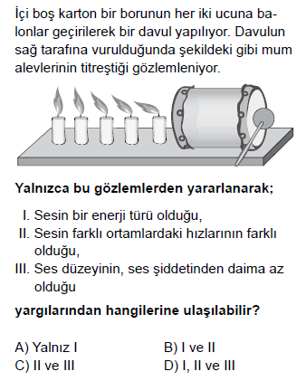
2015 TEOG NİSAN

Slide 42
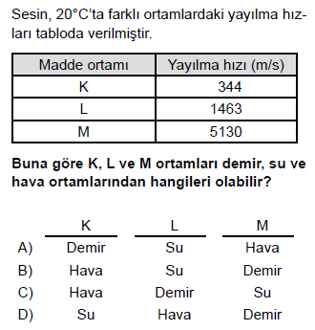
2015 TEOG MAYIS

Slide 43
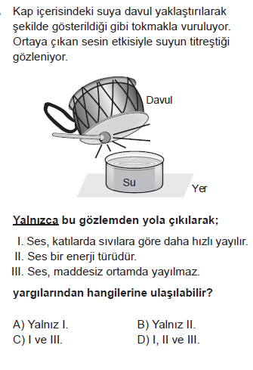
2016 TEOG NİSAN

Slide 44
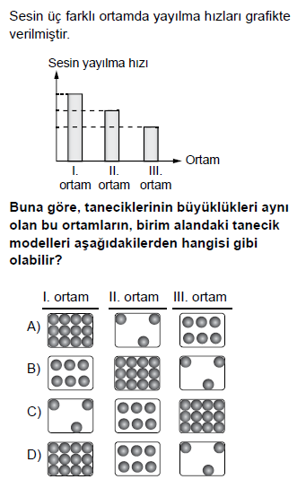
2016 TEOG MAYIS

