Slide 1
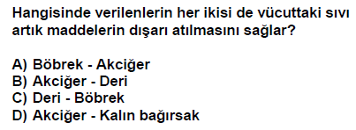
1999 DPY

Slide 2
2000 DPY

Slide 3
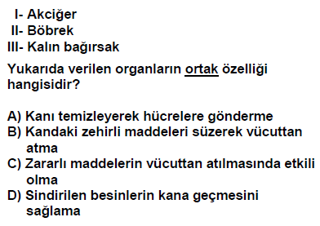
2006 DPY

Slide 4
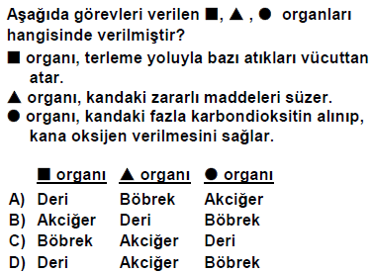
2007 DPY

Slide 5
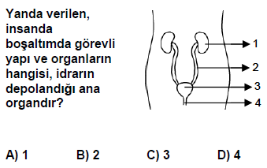
2008 DPY

Slide 6
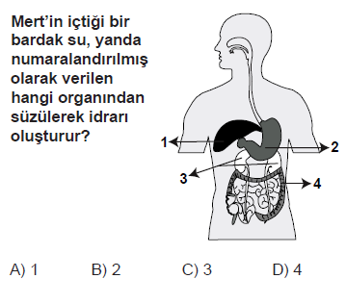
2009 PYBS

Slide 7
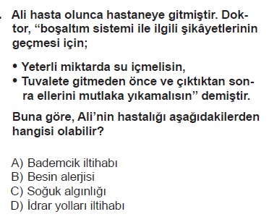
2010 PYBS

Slide 8
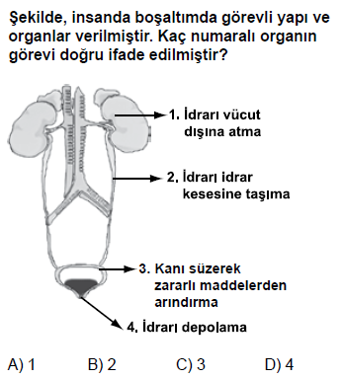
2011 PYBS

Slide 9
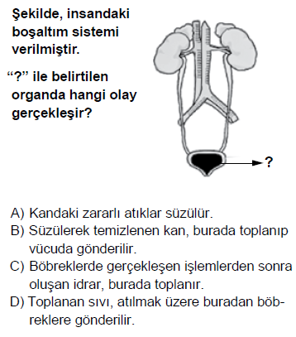
2012 PYBS

Slide 10
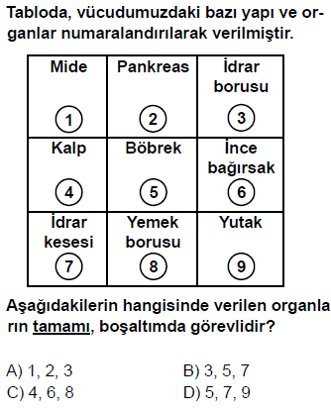
2013 PYBS

Slide 11
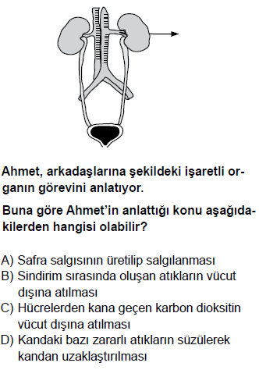
2014 PYBS

Slide 12
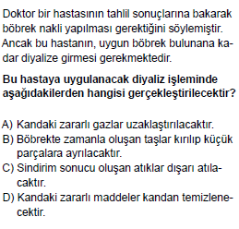
2015 PYBS

Slide 13
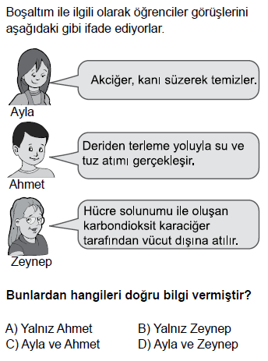
2016 PYBS

Slide 14
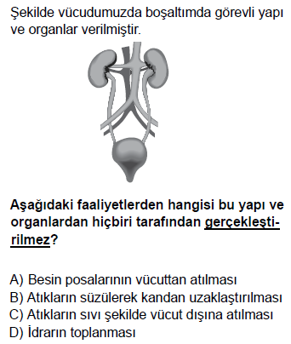
2016 PYBS

Slide 15
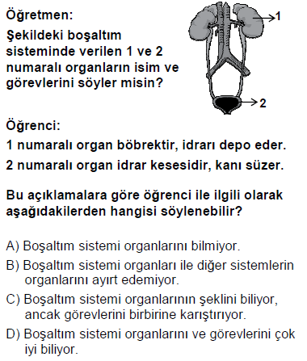
2008 SBS 7

Slide 16
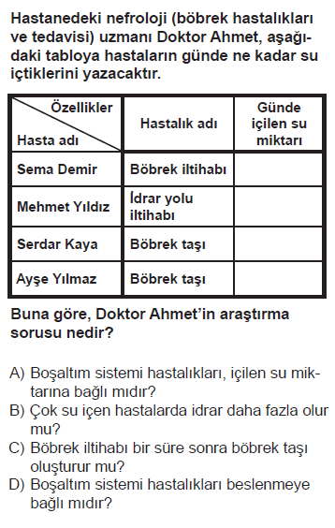
2008 SBS 7

Slide 17
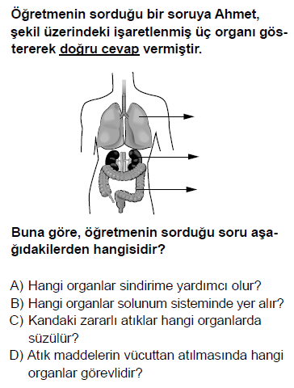
2012 PYBS 7

Slide 18
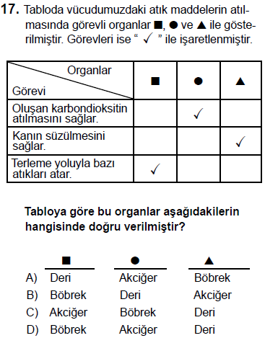
2015 PYBS 7

Slide 19
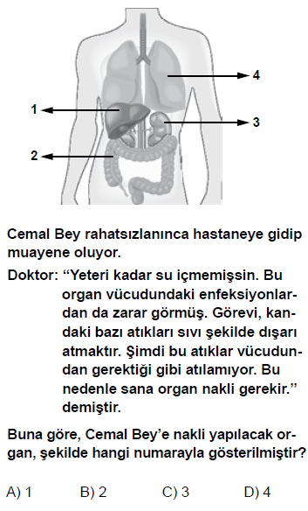
2013 PYBS 7

Slide 20
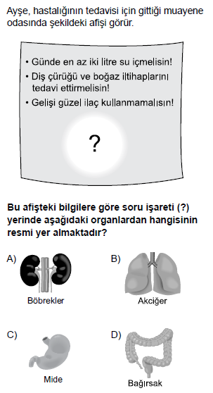
2016 PYBS 7

